Slide 1
Event-Driven Data Pipeline: Real-Time Monitoring and Analysis of Social Media Impressions
Ravali
Shreeja
Parisha

Slide 2
Business Logic
Real-Time Monitoring and Analysis of Social Media Impressions
The goal is to Develop an event-driven data pipeline using AWS services (such as Lambda, Step Functions, S3, DynamoDB, CloudWatch) and Python. This pipeline should automatically process and store social media impression data in real-time. The data should be aggregated, and made available for querying.

Slide 3
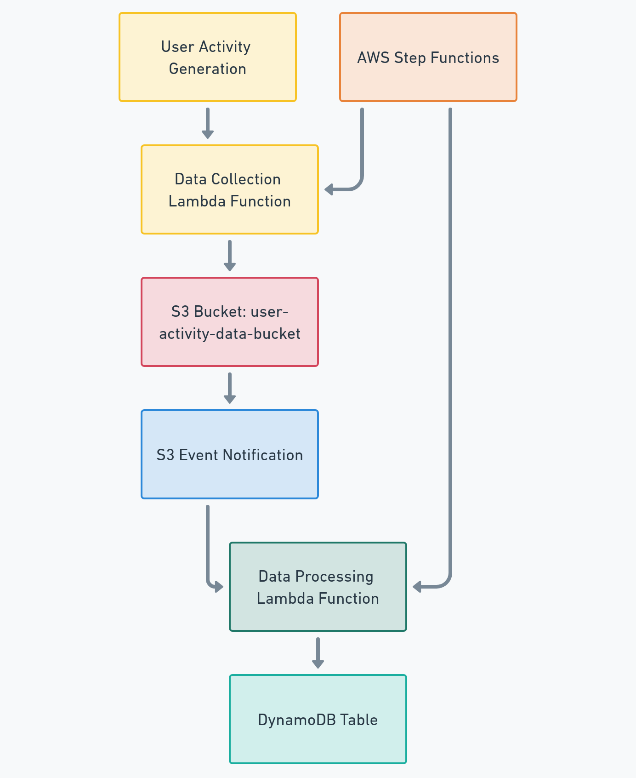
End-to-End Process Flow
User Activity Generation: Simulate or capture user activity data.
Data Collection: Trigger the Data Collection Lambda Function to handle incoming data.
Data Upload: Store the collected data in an S3 bucket (user-activity-data-bucket).
Event Notification: S3 triggers an event notification to signal data availability.
Data Processing: Activate the Data Processing Lambda Function to process the data.
Data Storage: Store processed data in a DynamoDB table.
Orchestration: Use AWS Step Functions to manage and coordinate the entire workflow.

Slide 4
Dataset
•user_id: Unique identifier for each user.
•session_id: Unique identifier for each session.
•timestamp: The time at which the action occurred.
•page_url: The URL of the page where the interaction took place.
•product_id: The identifier for the product involved in the action.
•action_type: The type of action performed (e.g., add_to_cart, page_view, purchase).
•referrer: The source from which the user was referred (e.g., Facebook, Snapchat).
•device_type: The type of device used (e.g., desktop, mobile, tablet).
•location: The geographic location of the user.
This dataset captures user interactions on a web platform, including actions like page views, add-to-cart, and purchases. Each entry logs the user’s activity with a timestamp, tracking their session and the specific page or product they interacted with.

Slide 5
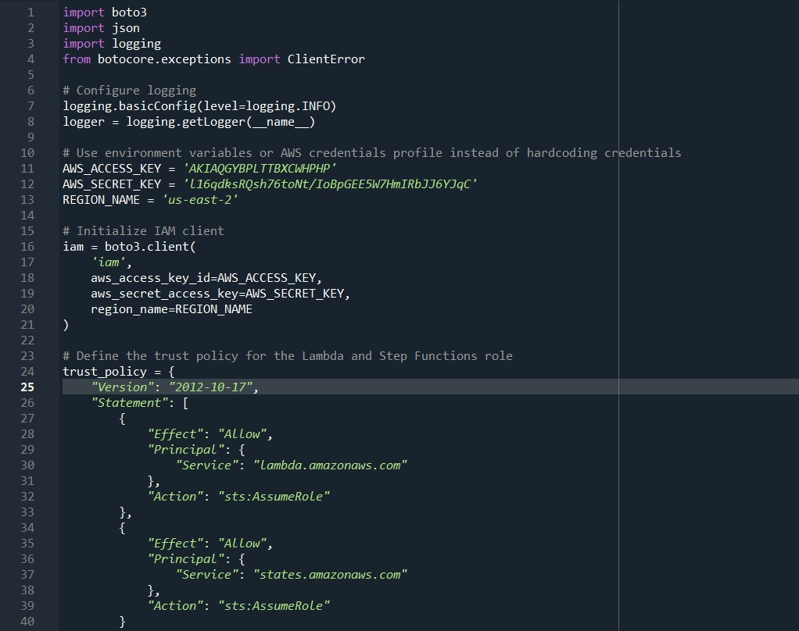
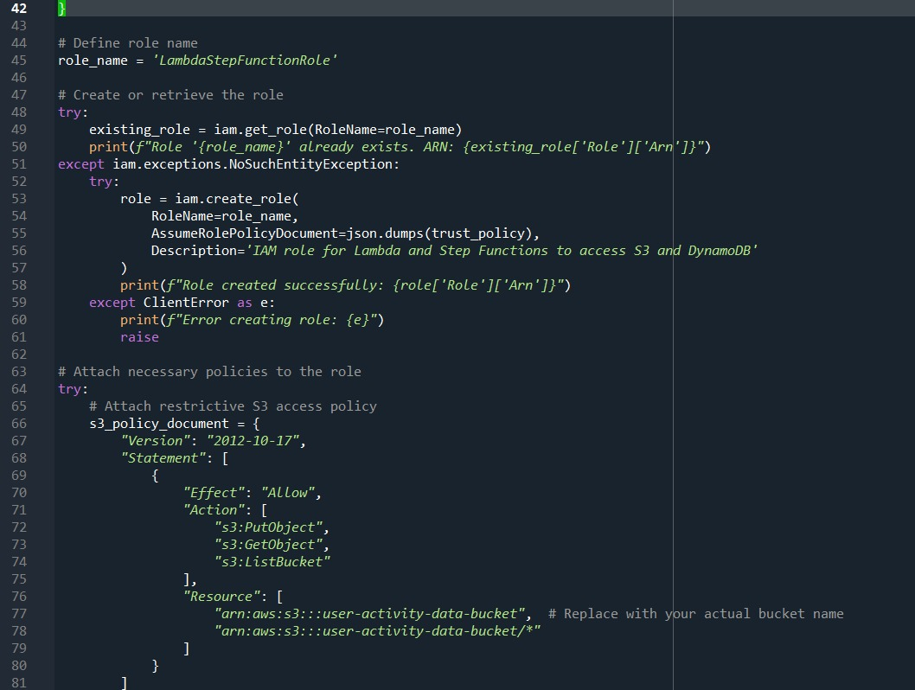
IAM Roles and Permissions

Slide 6
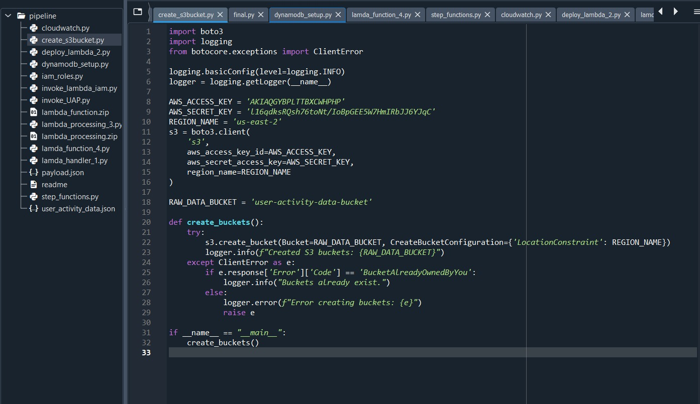
S3 bucket

Slide 7
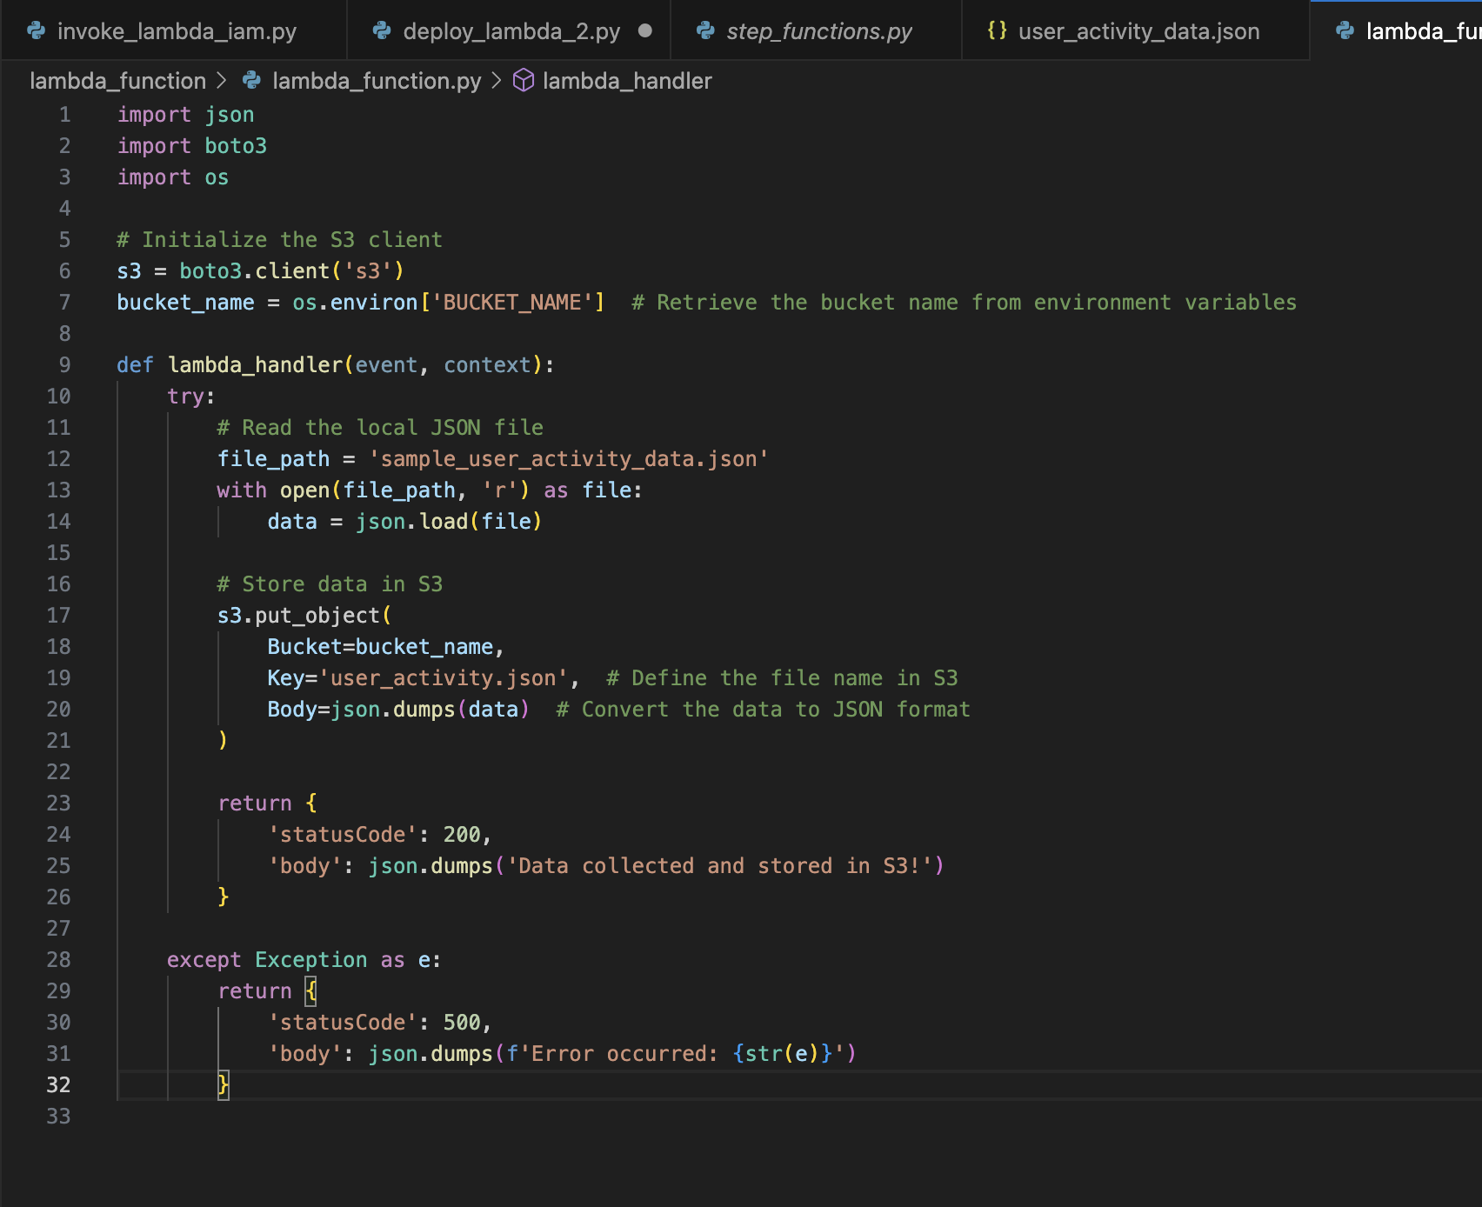
Data Collection
S3 Client Initialization:
Retrieve S3 Bucket Name:
Lambda Handler Function:
Store Data in S3:
Error Handling:

Slide 8
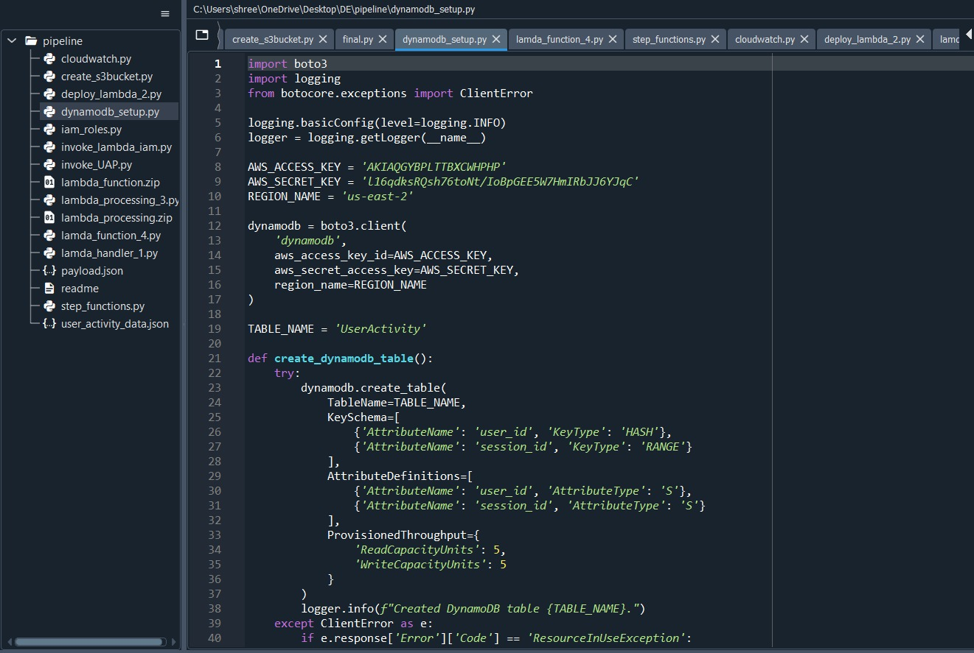
DynamoDB Setup

Slide 9
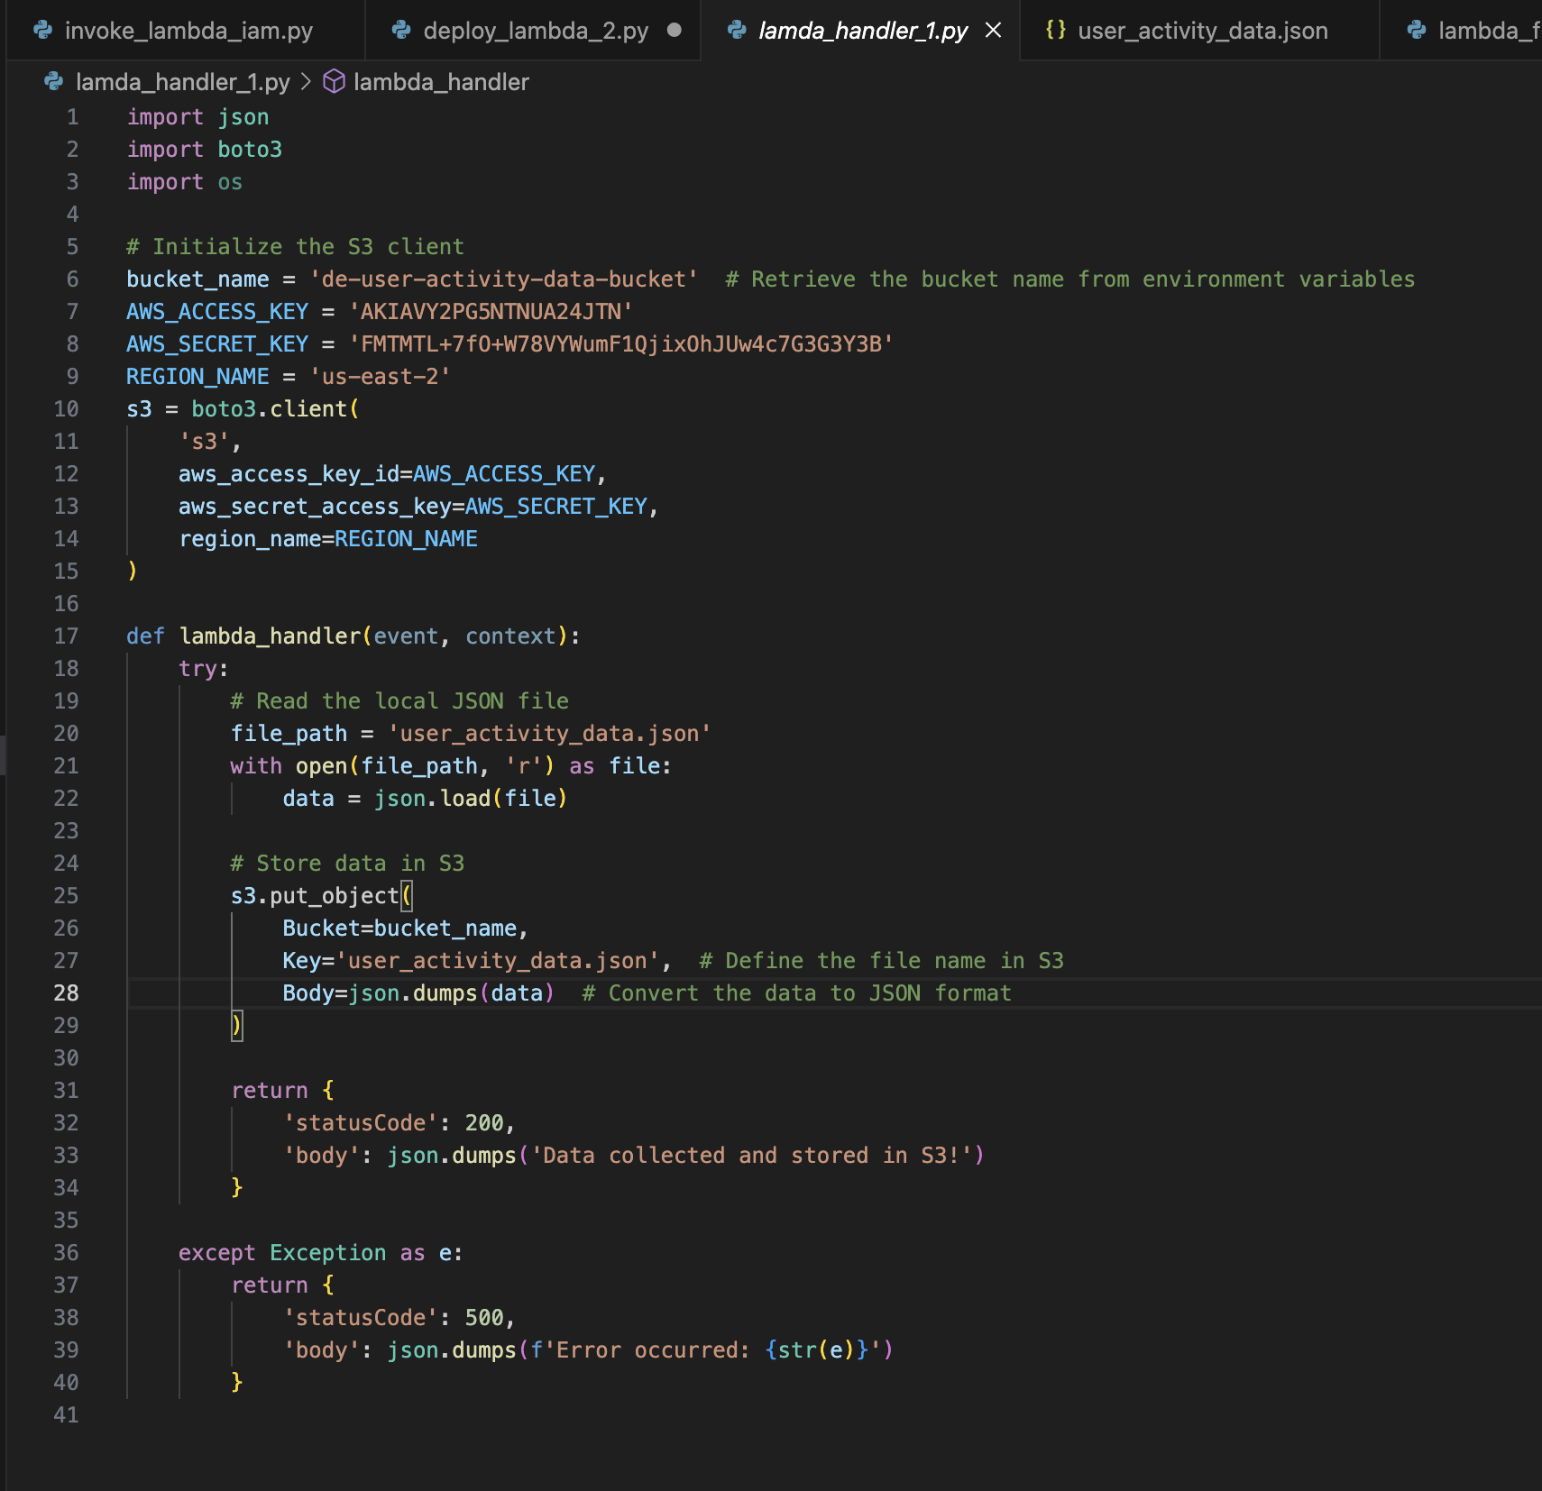
Data Upload
S3 Client Initialization: The function begins by establishing a connection to Amazon S3 using the boto3 library.
Data Reading: It reads data from a local JSON file named user_activity_data.json.
Data Upload to S3: The function uploads the read data to a designated S3 bucket (user-activity-data-bucket) using the put_object method, storing the JSON data for further processing.

Slide 10
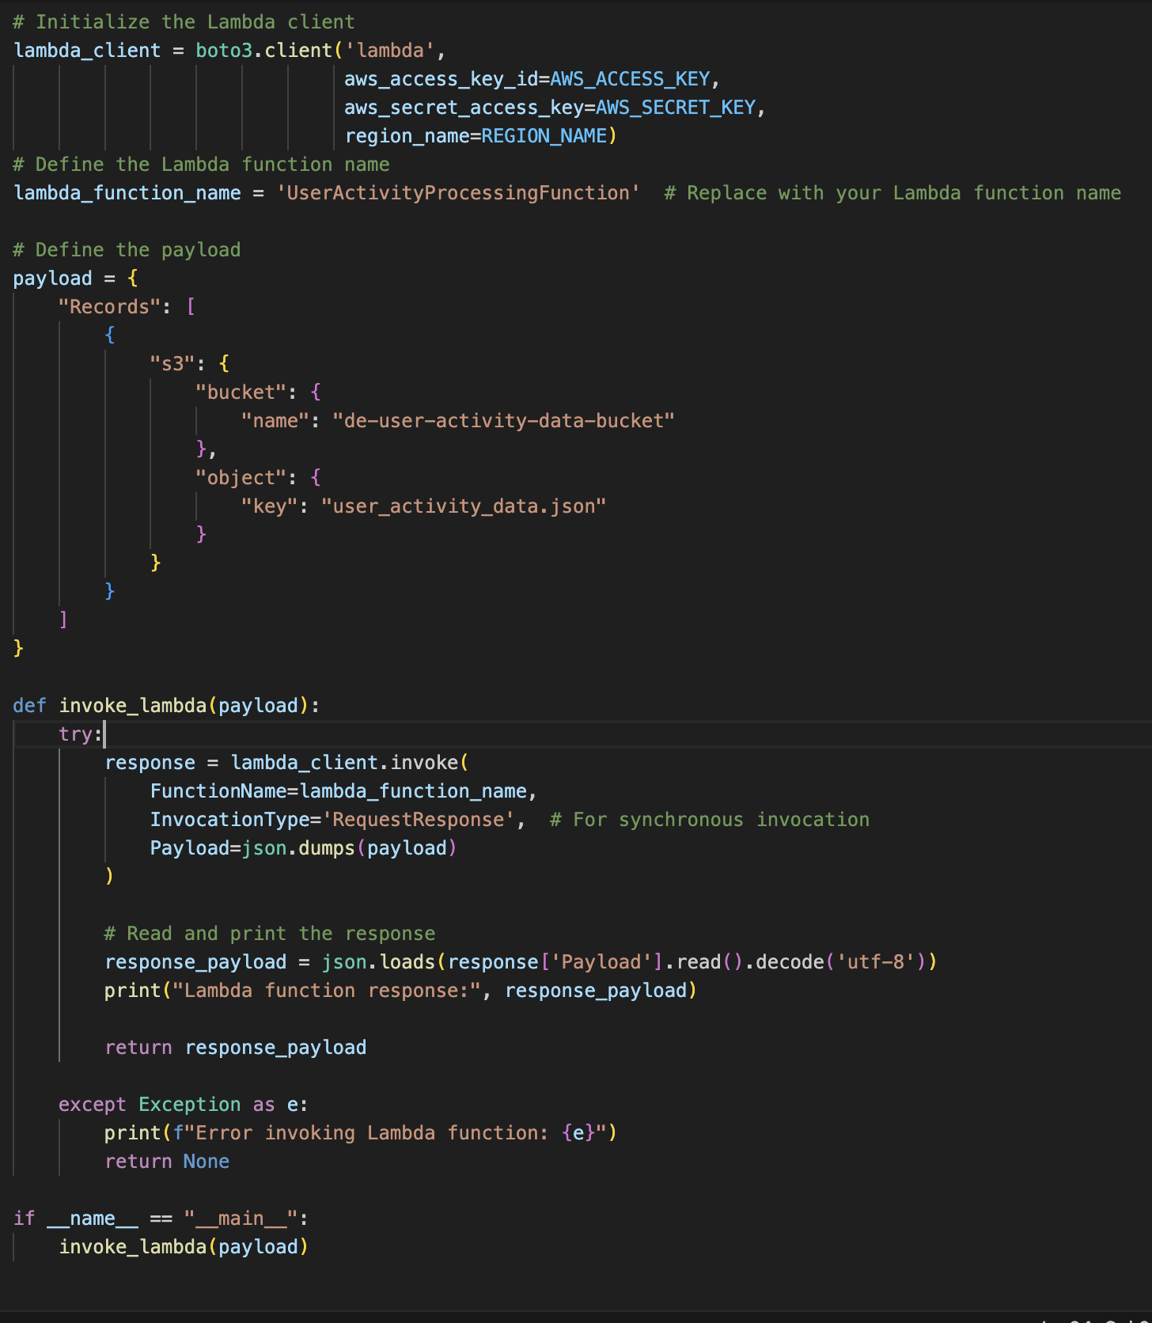
Event Notification
Lambda Client Initialization:
The script initializes a Lambda client using the provided AWS credentials and region.
Payload Definition:
A payload is defined to simulate an event where a file named user_activity_data.json is placed in the de-user-activity-data-bucket S3 bucket.
Lambda Function Invocation:
The invoke_lambda function triggers the UserActivityProcessingFunction Lambda function synchronously (waits for the response).
Error Handling:
Any errors encountered during the invocation are caught and printed.

Slide 11
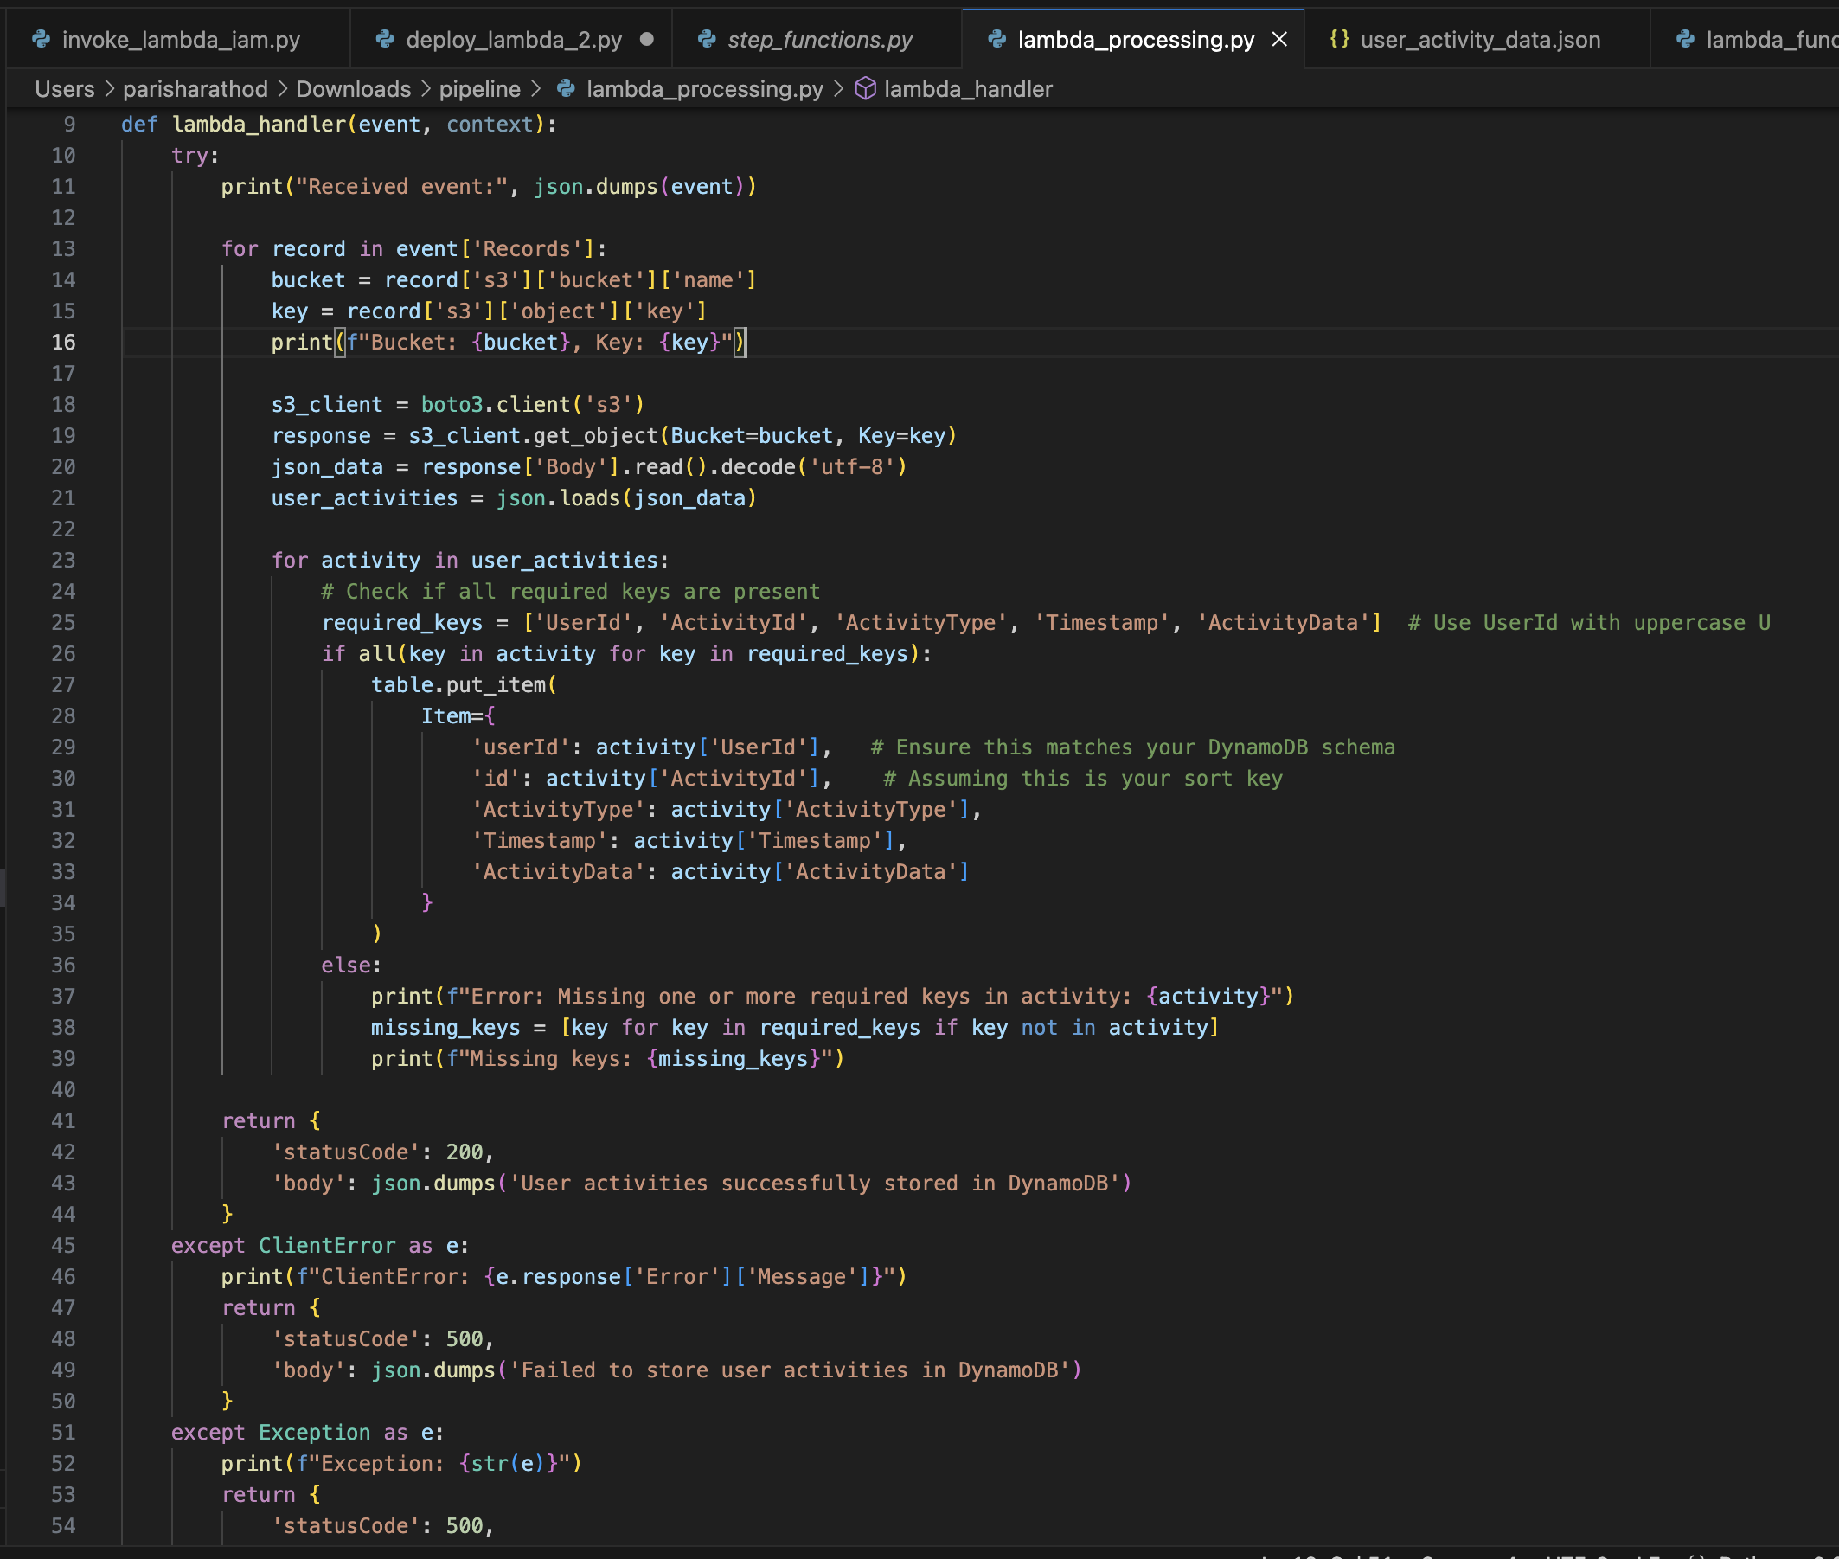
Data Processing
Event Trigger:
The function is triggered by an S3 event, indicating that a new object has been uploaded to a specified S3 bucket.
S3 Data Retrieval:
The function retrieves the bucket name and object key from the event and uses the S3 client to fetch the data stored in the bucket.
Processing the Data:
The fetched data, assumed to be in JSON format, is decoded and loaded into a Python dictionary.
The function checks for the presence of required keys (UserId, ActivityId, ActivityType, Timestamp, ActivityData) in each record.
Storing Data in DynamoDB:
If all required keys are present, the data is stored in a DynamoDB table (UserActivityTable) using the put_item method, with userId and id as the primary key and sort key.

Slide 12
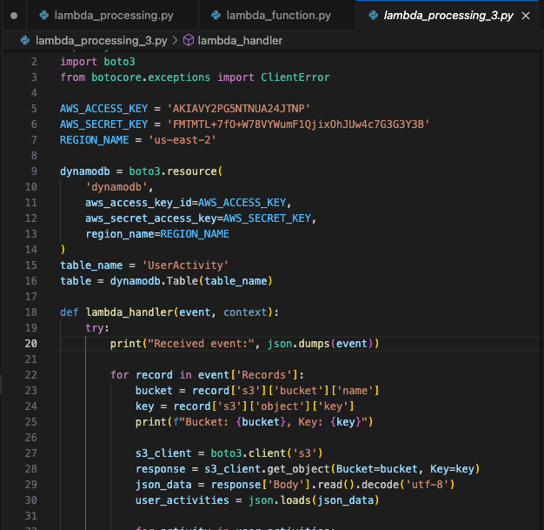
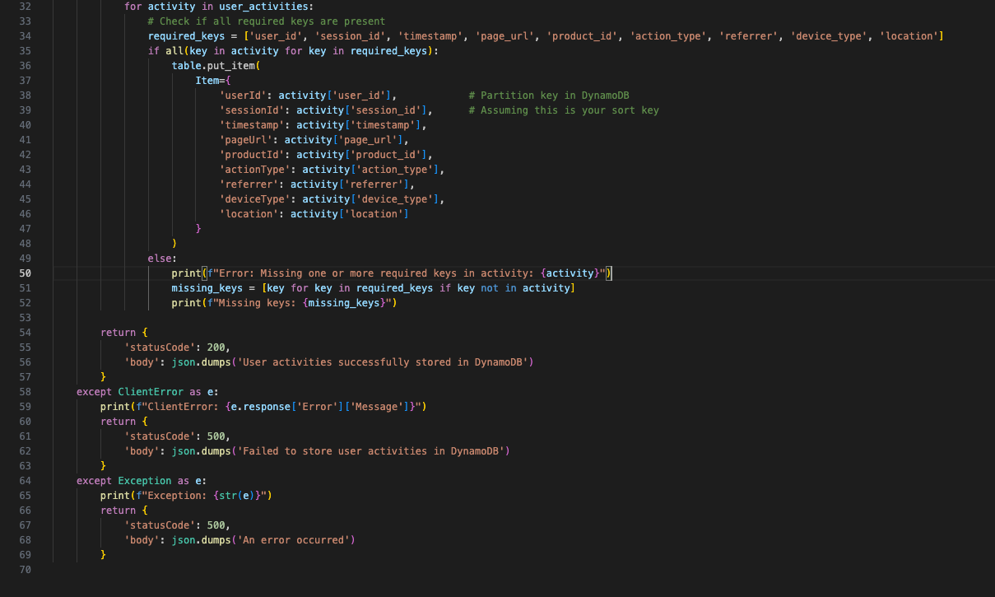
Data Storage: DynamoDB Table

Slide 13
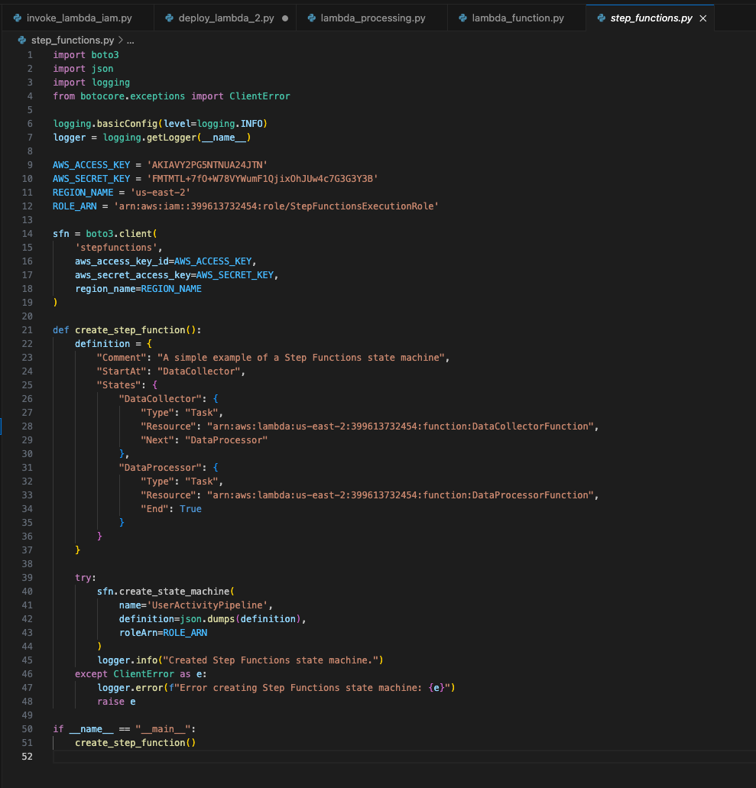
Orchestration: Step function
Initialize Step Functions Client
Define the State Machine
Create the State Machine
Execution Flow

Slide 14
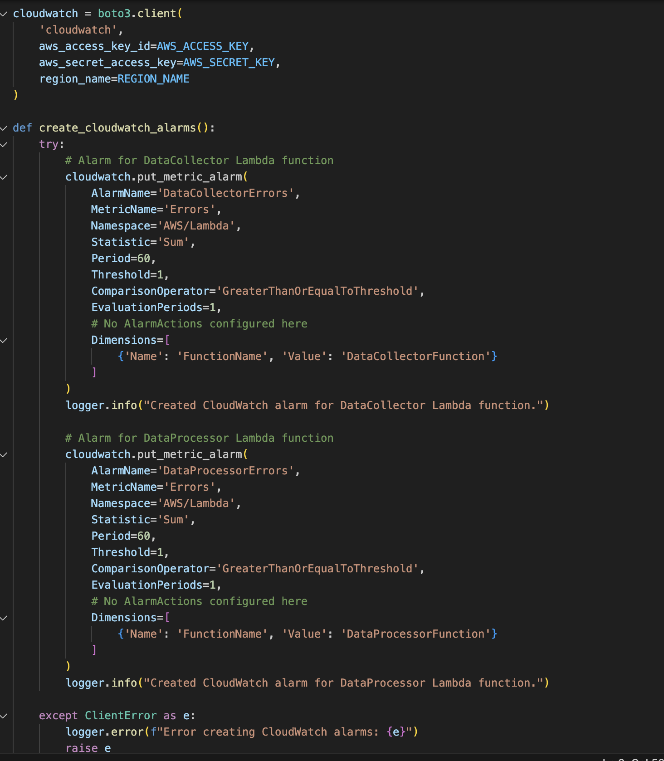
Monitoring with CloudWatch
DataCollectorFunction Alarm: Creates an alarm named DataCollectorErrors to monitor the error metric of the DataCollectorFunction Lambda. It triggers if errors occur more than once within a 60-second period.
DataProcessorFunction Alarm: Similarly, it sets up an alarm named DataProcessorErrors to monitor the error metric for the DataProcessorFunction Lambda under the same conditions.

Slide 15
Thank you

